Slide 1
Multivariate Analyses
NRES 776

Slide 2
Learning Objectives
Describe the way PCA and NMDS work
Decide when to use PCA vs NMDS
Report the results of a PCA or NMDS ordination

Slide 3
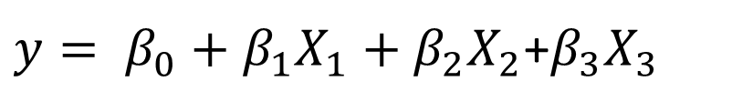

Univariate vs multivariate
Single response variable
Multiple response variable
$y= β_{0}+β_{1}X_{1}+β_{2}X_{2}$+$β_{3}X_{3}$
$$y=c(y_{1},y_{2},y_{3},y_{4})$$

Slide 4
Aims of multivariate statistics
Simplification, data reduction (ordination: PCA and NMDS)
Classification (discriminant analysis, cluster analysis)
Hypothesis testing (MANOVA, MRPP)

Slide 5
Ordination
Technique used to seek and describe patterns in multivariate data across a reduced set of axes
  No hypothesis tested
  Useful for:
    Selecting most important factors from multiple factors
    Separate strong, important patterns from weak ones
    Reveal unforeseen patterns and processes

Slide 6
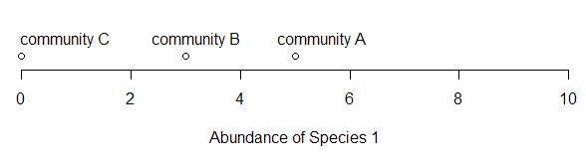
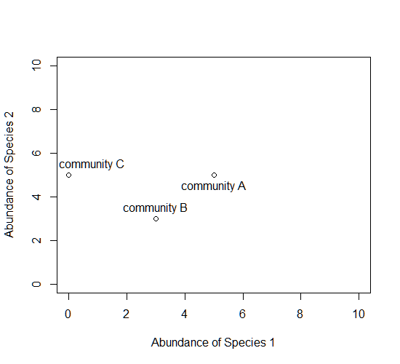
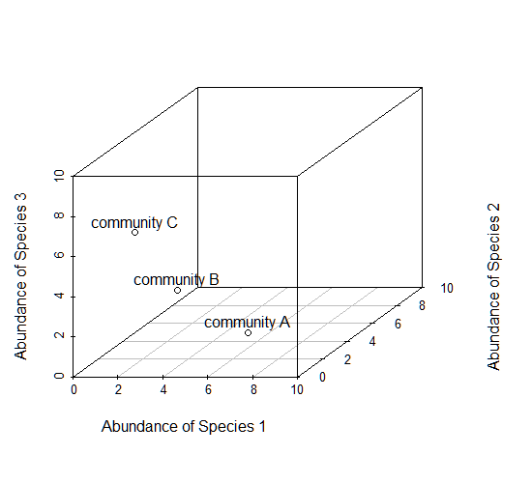
Ordination
One Axis of variation
Two axes of variation
Two Axes of variation
Two axes of variation
Three Axes of variation
Two axes of variation

Slide 7

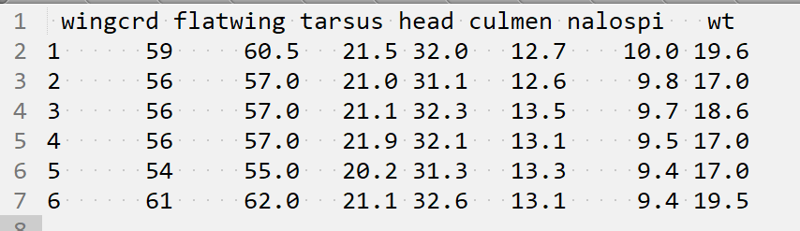
Principal Component Analysis
Morphometric data from saltmarsh sharp-tailed sparrows
7 variables, 1100 sparrows
How do these variables co-vary?
Notes:
Sparrow image: Wolfgang Wander - http://www.pbase.com/wwcsig/image/47346264

Slide 8
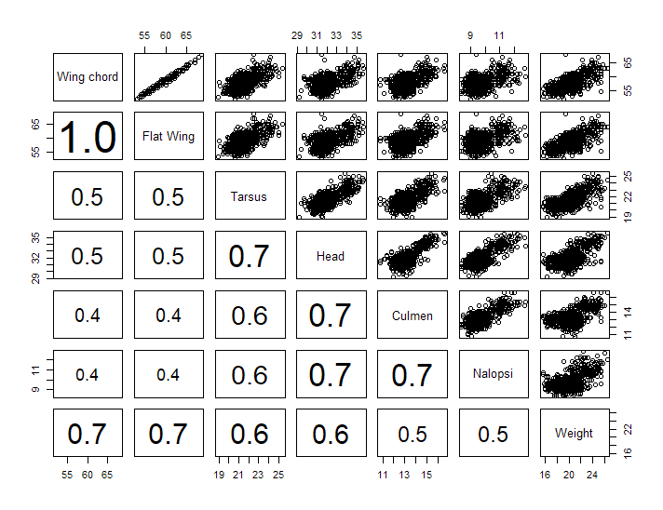
Principal Component Analysis
Notes:
General idea: cut planes through all the different two-variable combinations, many of those combinations will be correlated

Slide 9
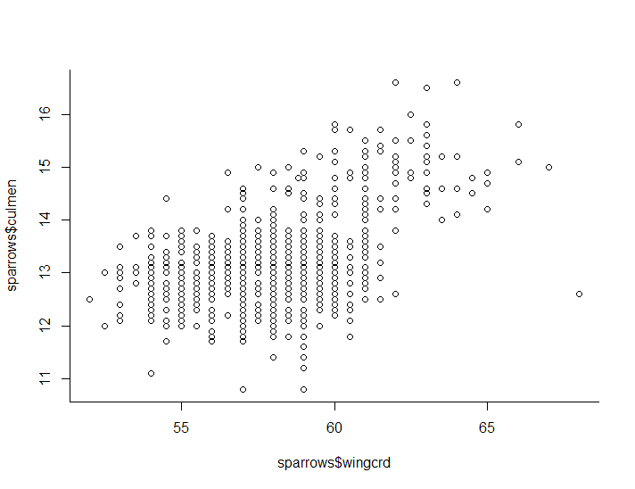
Principal Components (2-variables only)
PCA 1
PCA 2
Notes:
How PCA works
-simple example with two variables
-finds the principal axes of the best-fit ellipsoid to the data
-axes are perpendicular (orthogonal)
-these become your new axes (PCA1 and PCA 2)
-the axis with the most variation has the highest PCA score (loading)—explains most of the covariance among the variables
-fits as many axes as variables in the data, but some don’t explain much of the covariance, so they have low loadings

Slide 10
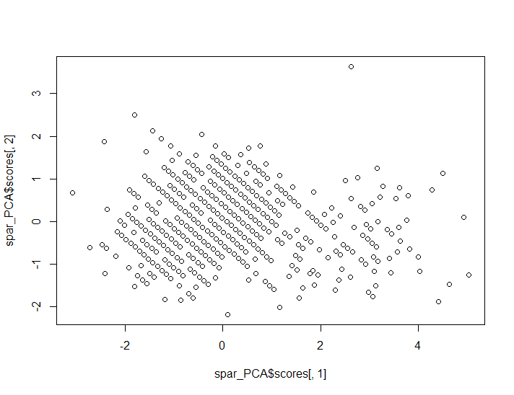
Principal Components (2-variables only)
PCA 2
PCA 1

Slide 11
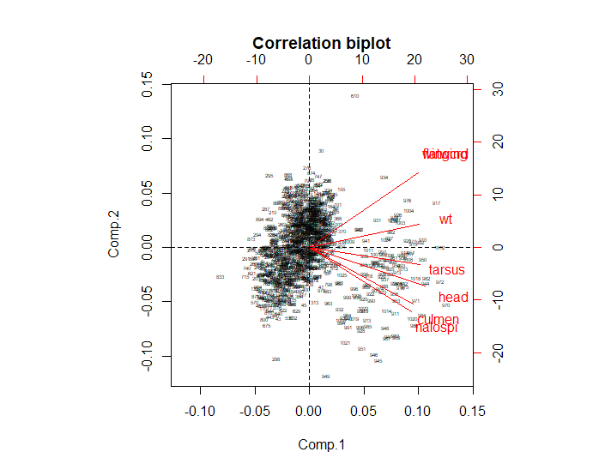
Principal Component Analysis (PCA)
Larger wing, smaller beak
Smaller wing, larger beak
Smaller
Larger
Notes:
Red lines=projection of axes in original data

Slide 12
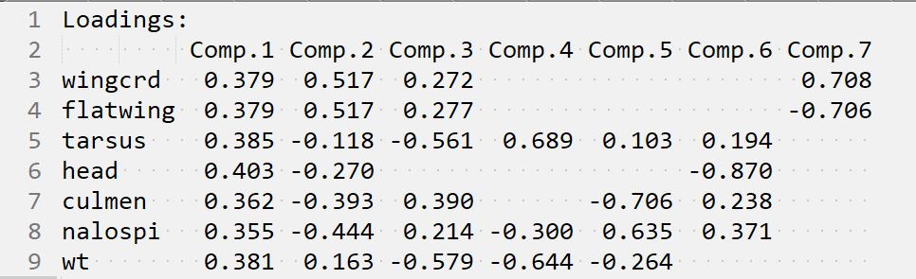
Principal Component Analysis (PCA)
Eigenvectors (Loadings)
Notes:
Loadings = direction of axes in the ellipsoid

Slide 13
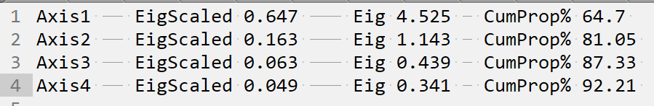
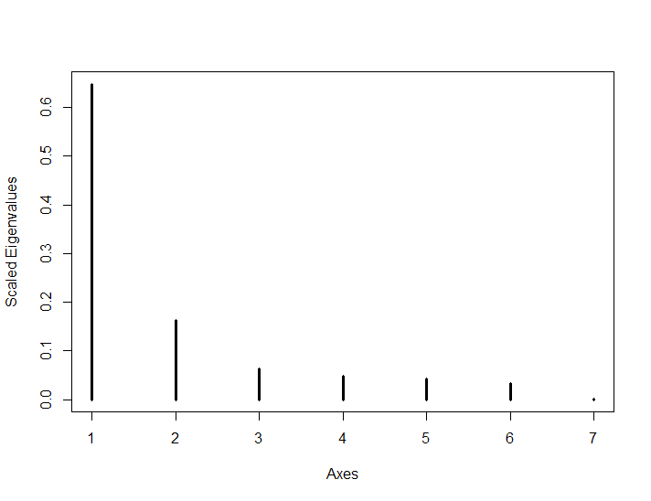
Deciding how many axes of variation to interpret
Notes:
Eigenvalues = length of axes of variation

Slide 14
Principal Component Analysis What to Report
Justification for using a linear model (if using for abundance data)
How many axes were interpreted & proportion of variation explained by those axes (eigenvalues)
Principal eigenvectors
If and how axes were rotated (for graphical display)
Interpretive display (plot showing eigenvectors, and groups as overlaps)

Slide 15
Principal Component Analysis Assumptions
Linear relationships among variables
Works well on body size data
Doesn’t work well on sparse data (e.g., lots of zeroes, such as abundance data)
Requires multivariate normality for statistical inference (not as important for descriptive purposes only)
Strongly affected by outliers

Slide 16
Non-metric multi-dimensional Scaling (NMDS)
An alternative type of ordination
Computer-intensive
Based on ranks
Method of choice for community data (species abundances, presence-absence)

Slide 17
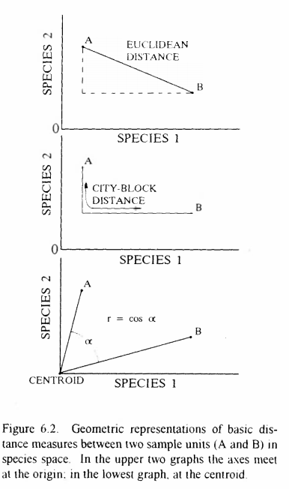
Advantages of NMDS
Avoids assumption of linear relationships among variables
Uses ranked differences
Can use any distance measure (method for calculating distances among data points in multivariate space)
Zero truncation & lots of zeros not a problem

Slide 18
How NMDS Works
Iterative solution
Repeatedly places samples in multivariate space and searches for a solution that minimizes the discordance between the original data matrix and the solution

Slide 19
NMDS Example
Numbers of 30 plant species measured in 10 communities
sp1 ….. sp30
community1 42 83
community2 20 90
community3 21 91
community4 23 67
community5 74 89
community6 38 62
………
community10 78 93

Slide 20
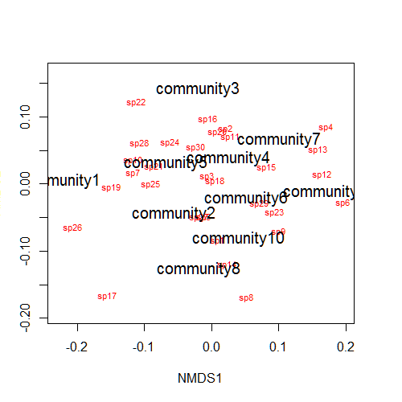
NMDS Example
Numbers of 30 plant species measured in 10 communities

Slide 21
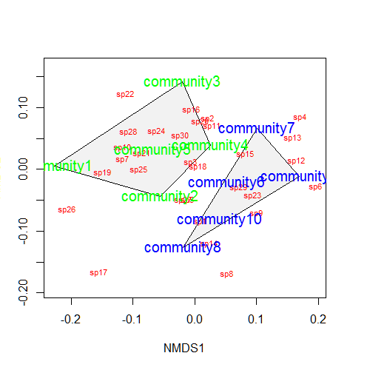
NMDS Example
Apply visualization tools (e.g., treatments)

Slide 22
What to Report
Distance measure used (e.g., Bray-Curtis, Sorenson)
Software used
Approach to starting configuration
Number of runs
Number of dimensions retained
# iterations and stability of the final solution
Proportion of variance explained by each axis
Appropriate graphical display

Slide 23
Summary
Ordination methods are useful for representing complex multivariate data as smaller numbers of key variables
PCA
  Ordination method that works well for data with linear relationships with few zeroes
  NMDS
    Ordination method that works well on sparse datasets (e.g., species presence and abundance)

